Slide 1
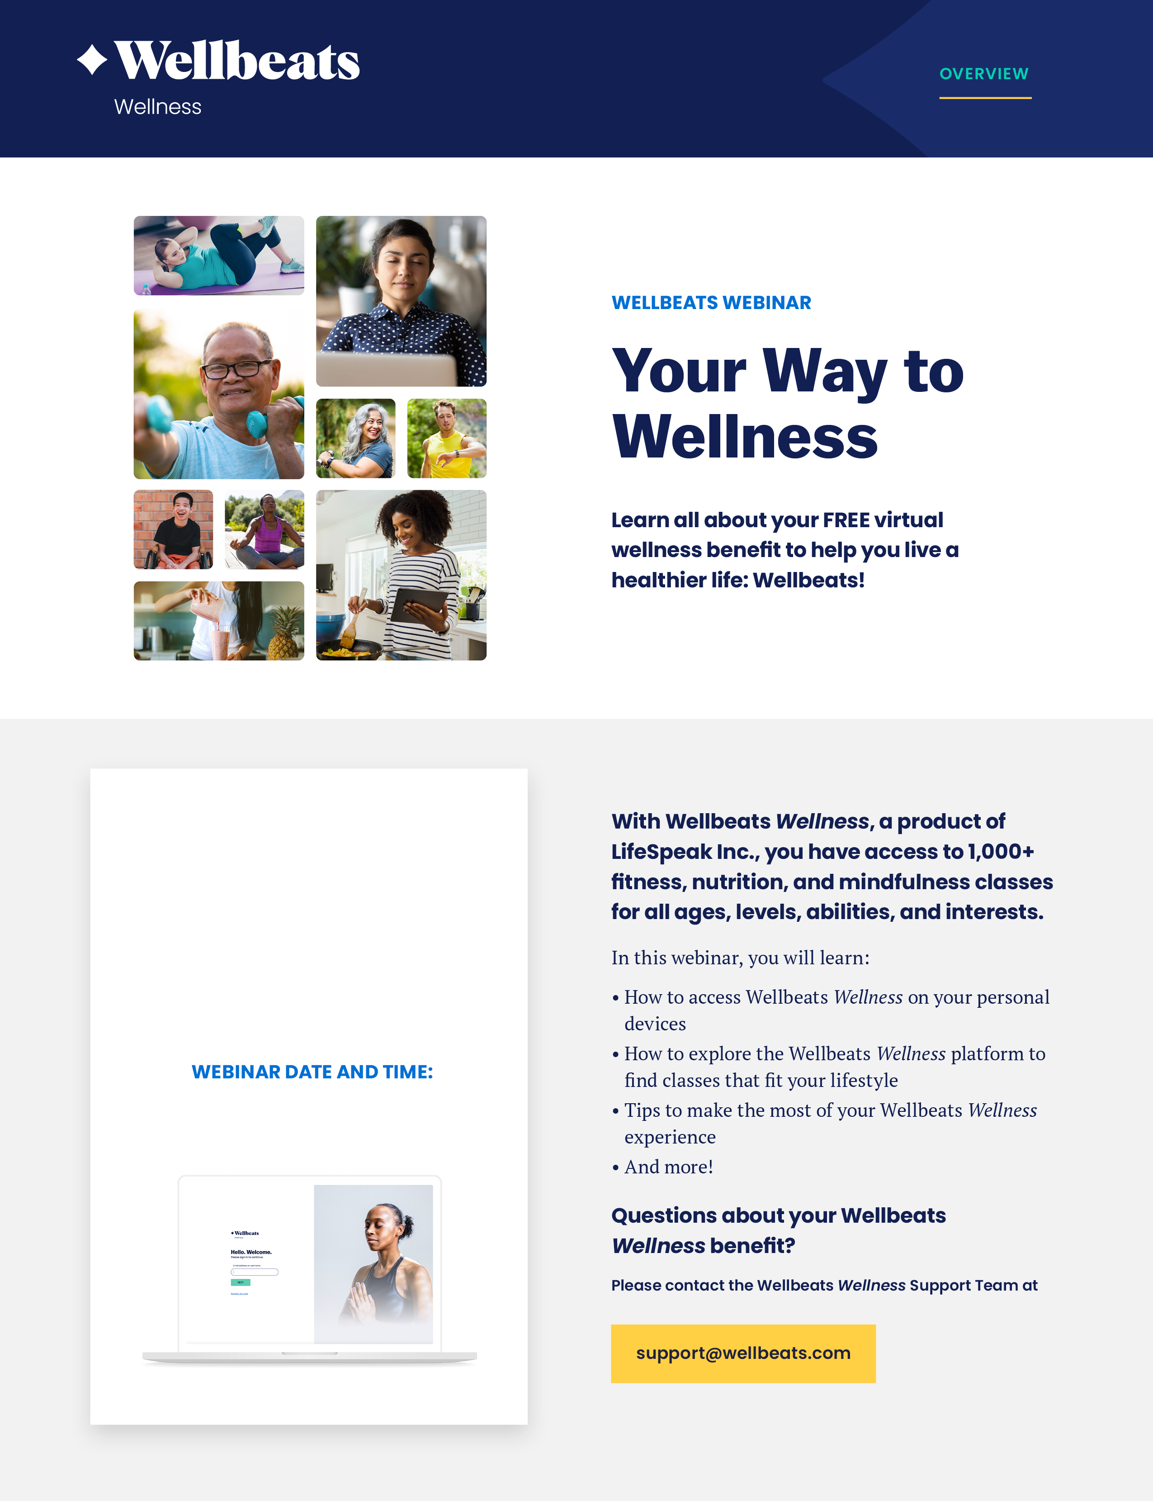
[Insert Date and Time here: Wednesday, January 5th, 2022, at 12:00 PM CST].

